Slide 1
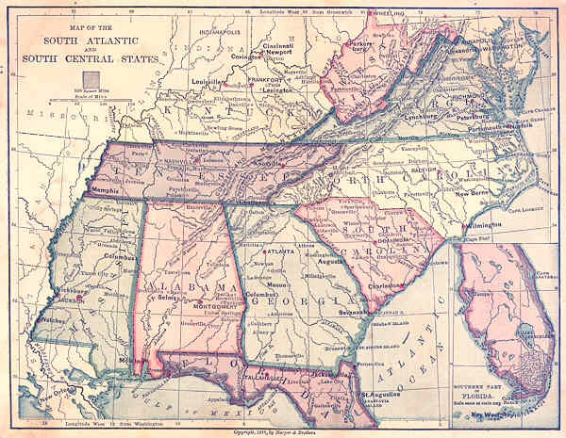
South Atlantic States
A Different Kind of State

Slide 2
Early Cash Crops
Virginia, the Carolinas, Georgia and Florida grew tobacco, rice, and cotton.

Slide 3
Virginia: Old Dominion
Capital: Richmond
Motto: Sic semper tyrannus: Thus always to tyrants.
State bird: Cardinal
State flower: Dogwood
The 10th state: June 25th, 1788

Slide 4
Jamestown: 1609
London Company of England sent 3 ships to Virginia.
Colonists were poorly prepared
John Smith saved Jamestown colonists with his “no work, no eat” ethic.
Winter came and it was starving time. Only 1/3 of colonists survive.
Virginia Company Seal

Slide 5
Map of Jamestown

Slide 6
North Carolina: Tar Heel State
Capital: Raleigh
Esse quam videri: “To be rather than to be seen.”
State bird: Cardinal
State flower: Dogwood
12th state: Nov. 21, 1789

Slide 7
Roanoke: The Lost Colony
Sir Walter Raleigh got a charter from Queen Elizabeth to start a colony in 1584.
the colonists didn’t survive the wilds of North America.
They thought treasure was going to be lying on the ground.
(Maybe that’s why there’s a record-breaking number of shipwrecks off Hatteras Cape….)
Hatteras Island and Roanoke

Slide 8
South Carolina: The Palmetto State
Capital: Columbia
Motto: Dum spiro spero: “While I breath I hope.”
State bird: Carolina wren
State flower: Yellow jessamine
8th state admitted to the Union on May 23rd, 1988

Slide 9
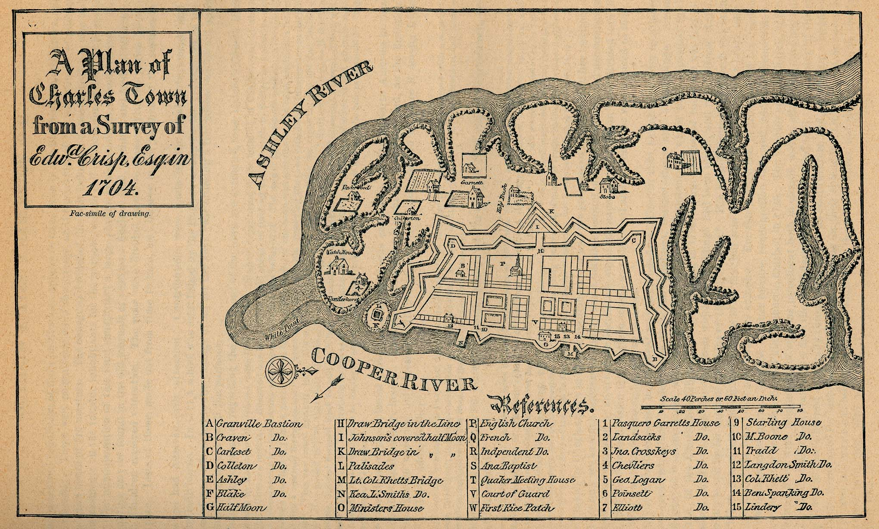
Early South Carolina Colonization
Later it became an English colony, part of what was then “Carolina”—or Charles Land.
It tolerated various religions, including French Hugenots (Hugh-zhen-oh—a kind of Calvinist) and Sephardic Jews (Spanish)
Hernando DeSoto, 1540, a Spanish conquistador, first explored it.

Slide 10
Georgia: The Peach State
Capital: Atlanta
Motto: Widsom, Justice, Moderation
State bird: Brown thrasher
State flower: Cherokee rose
4th state admitted to Union, Jan. 2nd, 1788

Slide 11
Early French Settlement: Another Lost Colony
French Hugenots tried to start a colony in Georgia in 1562 on Paris Island.
The Colony failed within a year. Meanwhile, only a few Spanish conquistadors explored the area.
Later an English settlement develops in 1690, almost 130 years later.

Slide 12
Florida: The Sunshine State
Capital: Tallahassee
Motto: In God We Trust
State bird: Mockingbird
State flower: Orange blossom
27th state admitted to Union, March 3rd, 1845

Slide 13
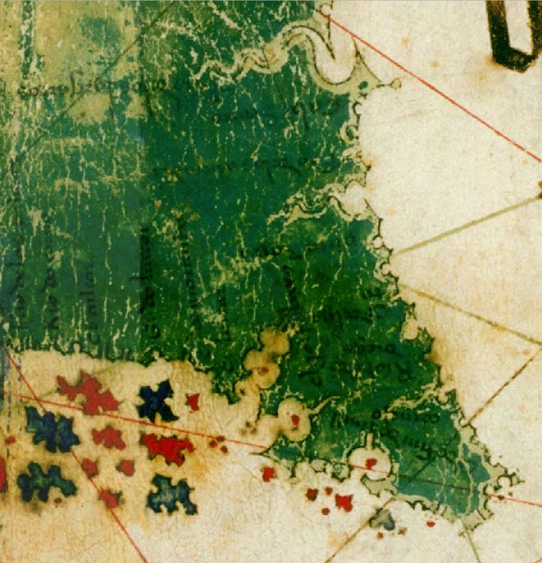
Colonial Florida
Ponce De Leon
First European explorer of Florida in 1513
The failed Georgia colony settled in Florida at Fort Caroline in 1564.
English only control Florida after the French and Indian War, 1763.
Then the Americans revolt….
Early Spanish Map of Florida

